Slide 1
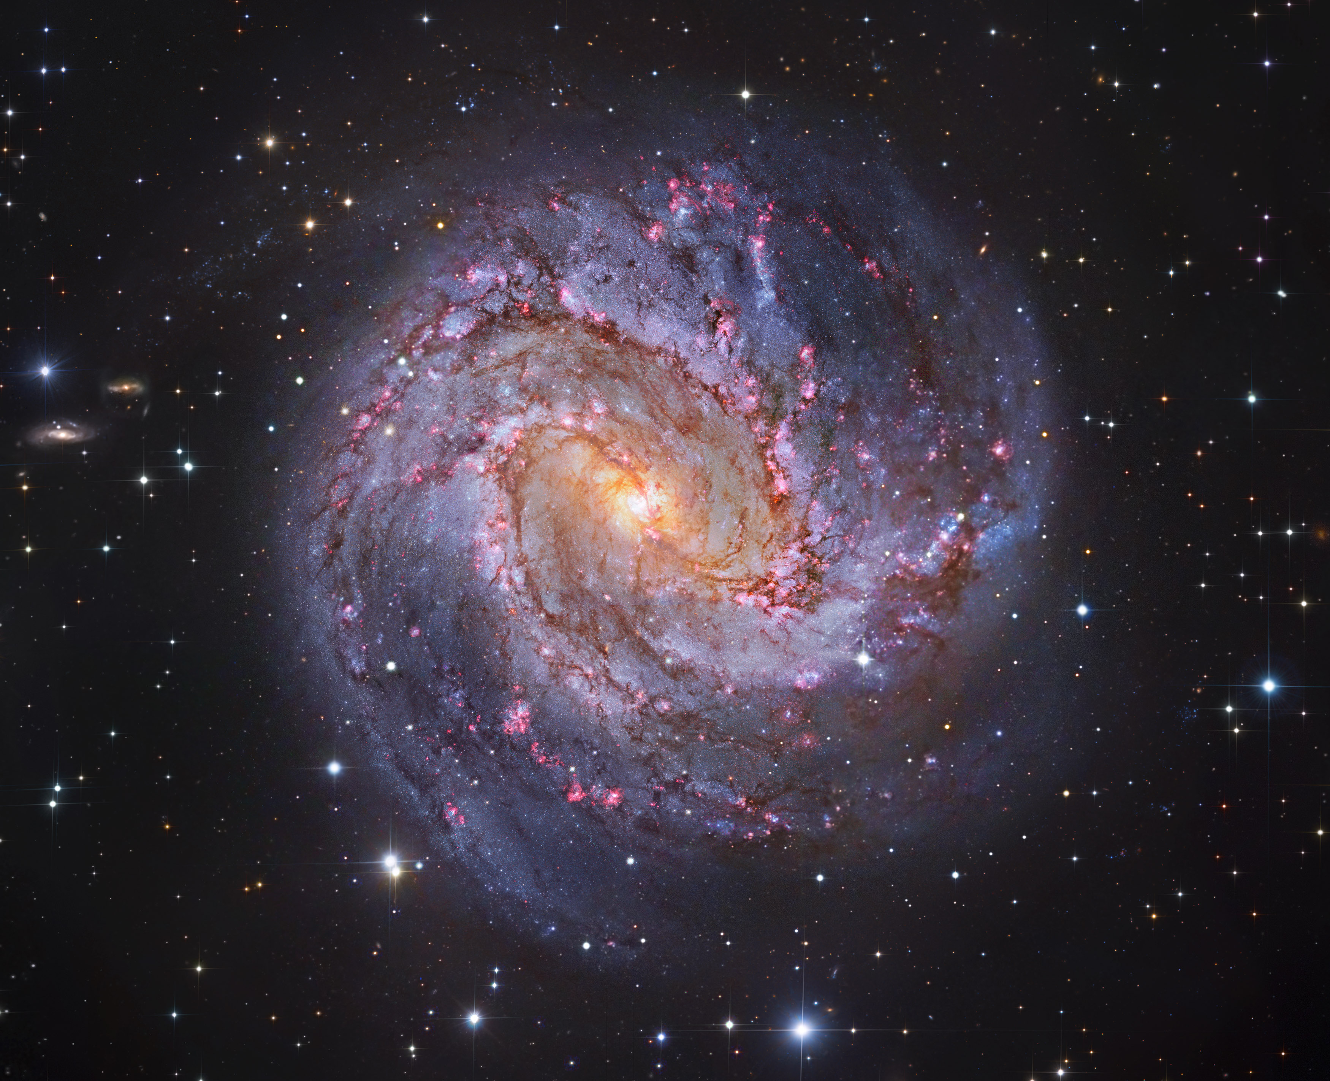


The Formation of Spiral Structures in the Flocculent Galaxy M83
HST image of M83
Investigators: Bradley Moldermaker and Benjamin Pieczynski
Mentor: Dr. Lisa Chien

Slide 2
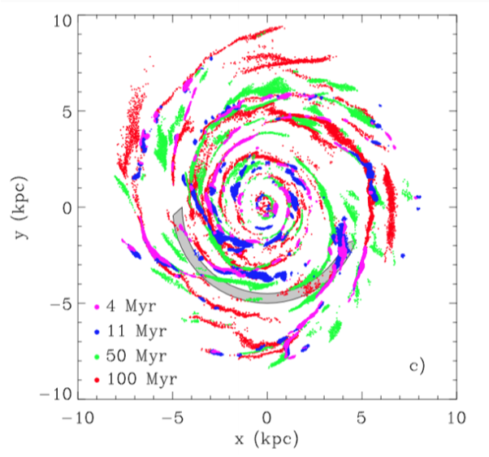
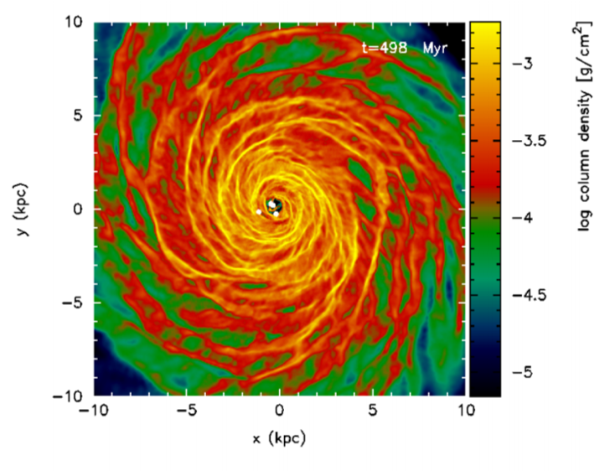
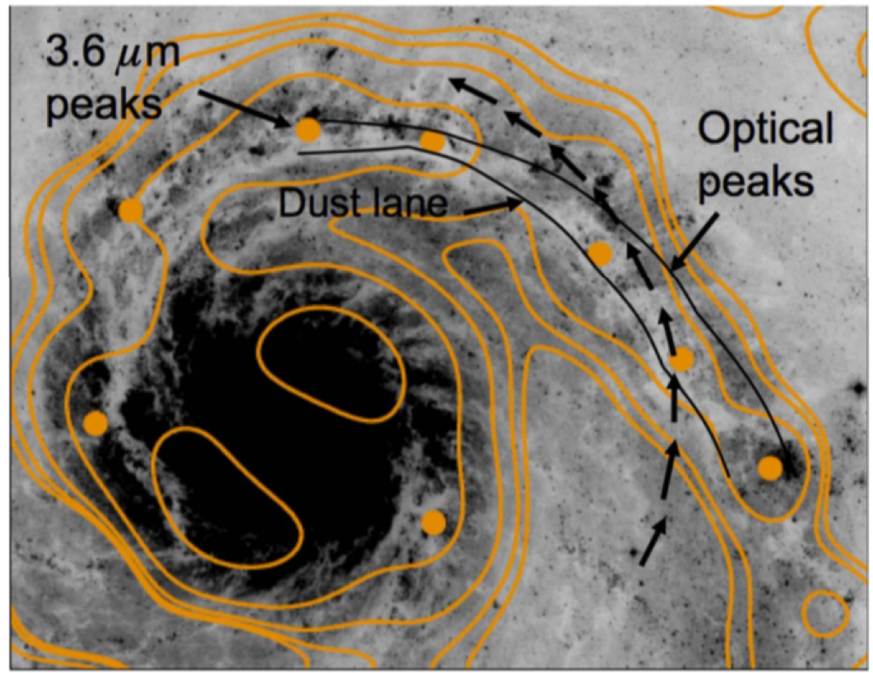
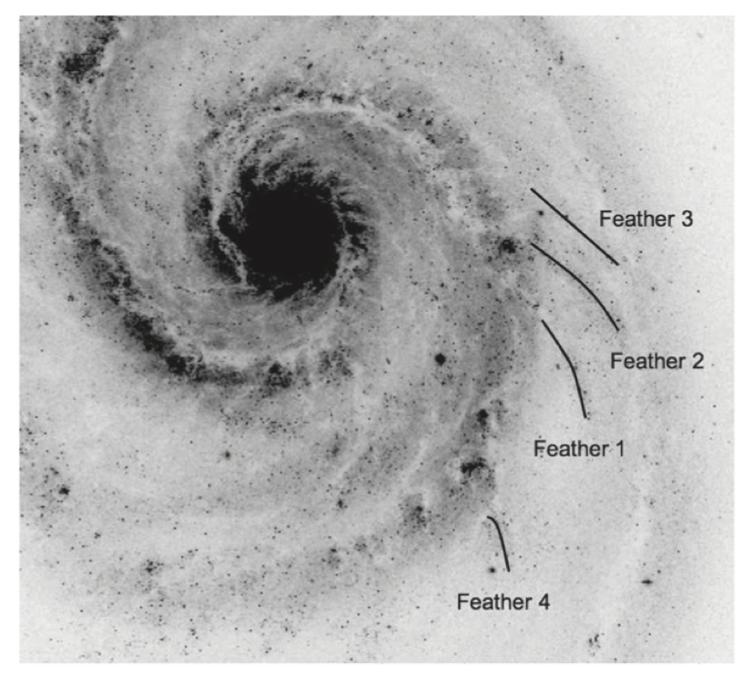
RESEARCH BACKGROUND
Theoretical Modeling [1]
Theoretical models for flocculent type galaxies
Estimated positions of star clusters by age (left)
Theoretical column density (right)
M51 [2]
Research done on interacting Galaxy M51
Cluster distributions matched Dobbs & Pringle (2010) expectations
Progression from dust lanes to gas arms to star clusters (left)
Feathers seen in M51 (right)
REFERENCES
[1] Dobbs & Pringle, 2010, MNRAS, 409, 396.
[2] Chandar, R., Chien, L.-H. et al, 2017, ApJ, 845, 75.
Notes:
Mention feathers are literally identified by eyes for M51, which tells us that the research on feathers are still very new.....

Slide 3

M83 BACKGROUND
M83
Starburst Nucleus
Active Star Formation & Young Clusters [3]
Prominent Dust Lanes
SAB(s)c type galaxy
4.6 Mpc distance
Possible multicore nuclei [4]
REFERENCES
[3] Whitmore, C., Chandar, R. et al, 2011, ApJ, 729, 78.
[4] Díaz, R., Dottori H. et al, 2006, ApJ 652, 1122.
Notes:
Mention multicore nuclei, which causes instability of the disk, can be what’s producing feathers in Sc-type galaxies... (and other mechanisms...)

Slide 4
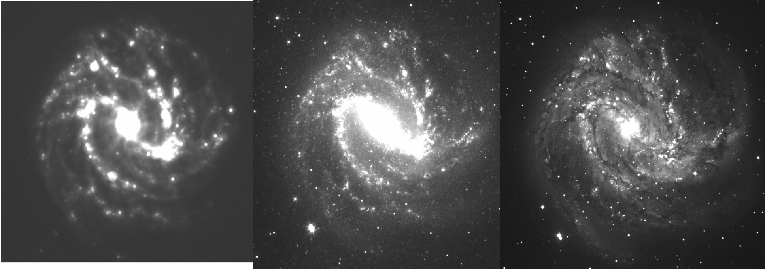
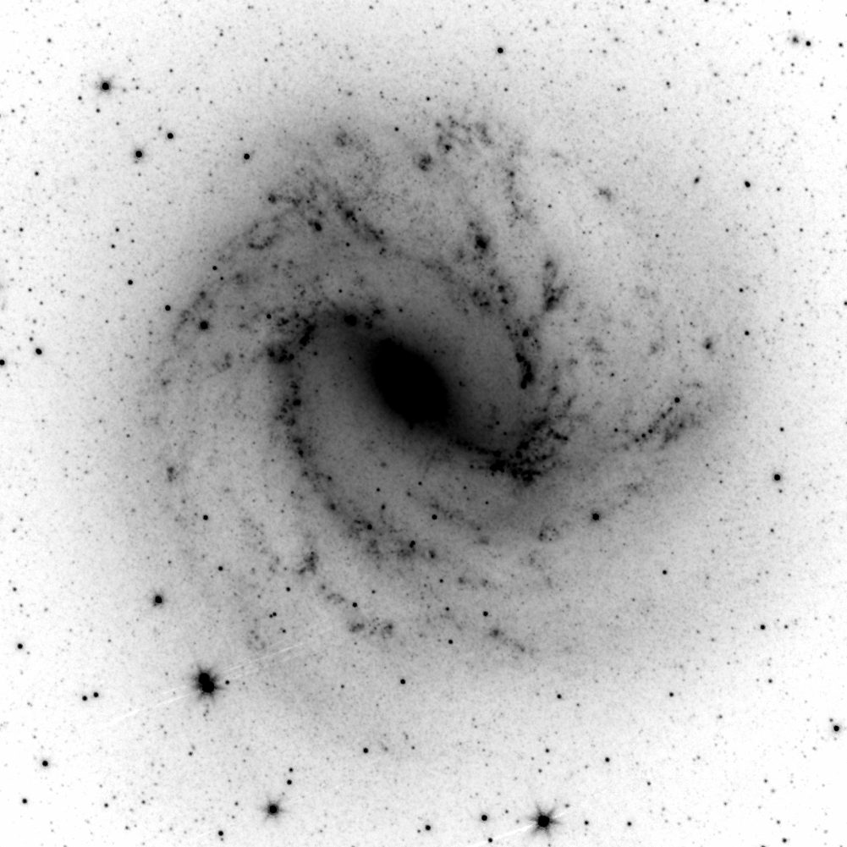
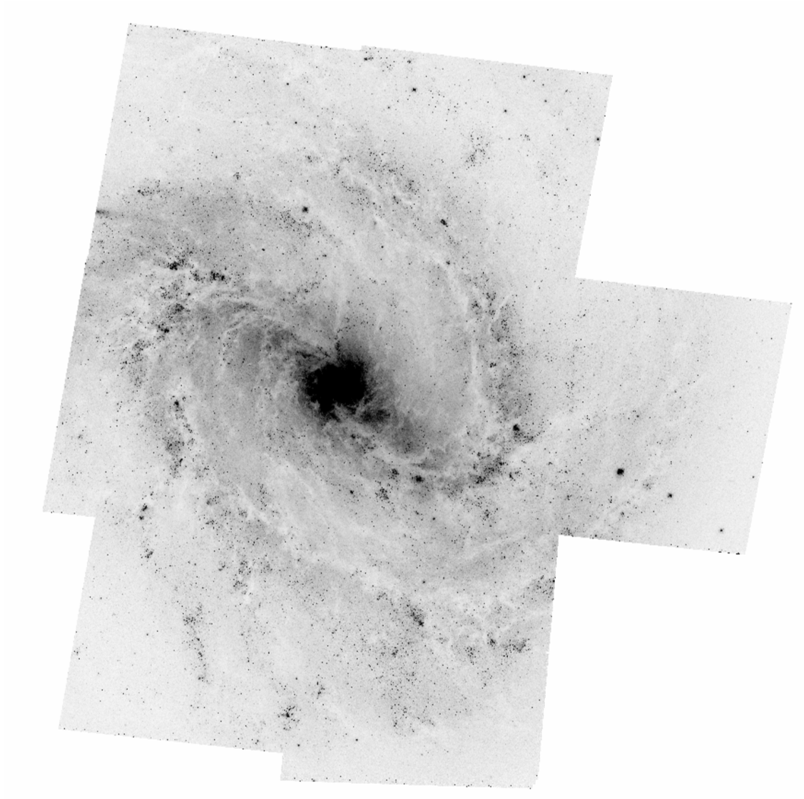
DATA
From NASA/IPAC Extragalactic Database (NED)
CO image, in 3.6-micron (infrared) from Spitzer Telescope
Cluster locations and ages derived from Hubble Space Telescope (HST) multi-color mosaic images
(from Dr. Whitmore, private discussion)
Above: Far IR, Near IR, and Visible light images
Spitzer 3.6-micron image
HST mosaic image

Slide 5
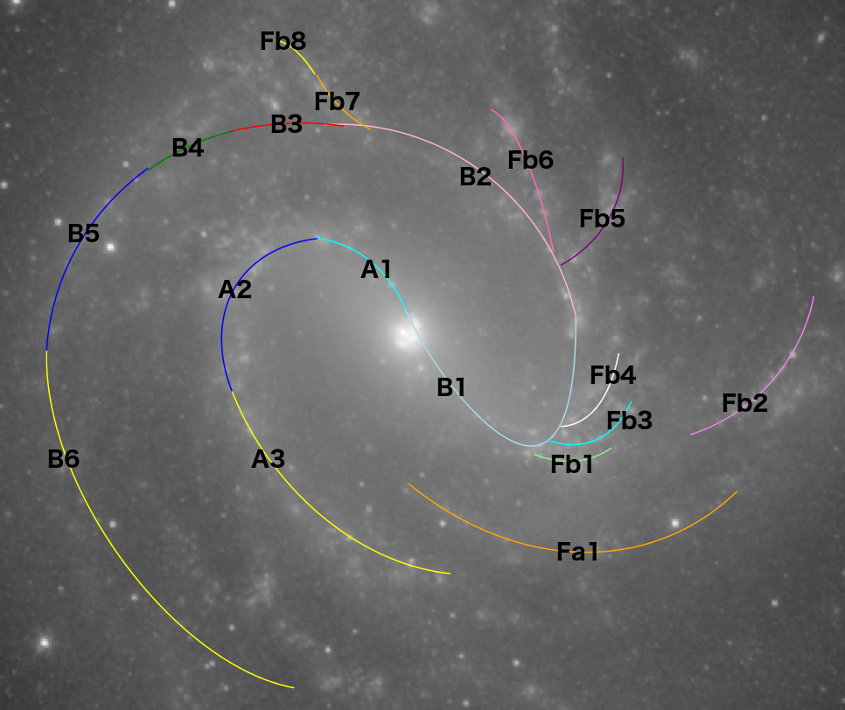
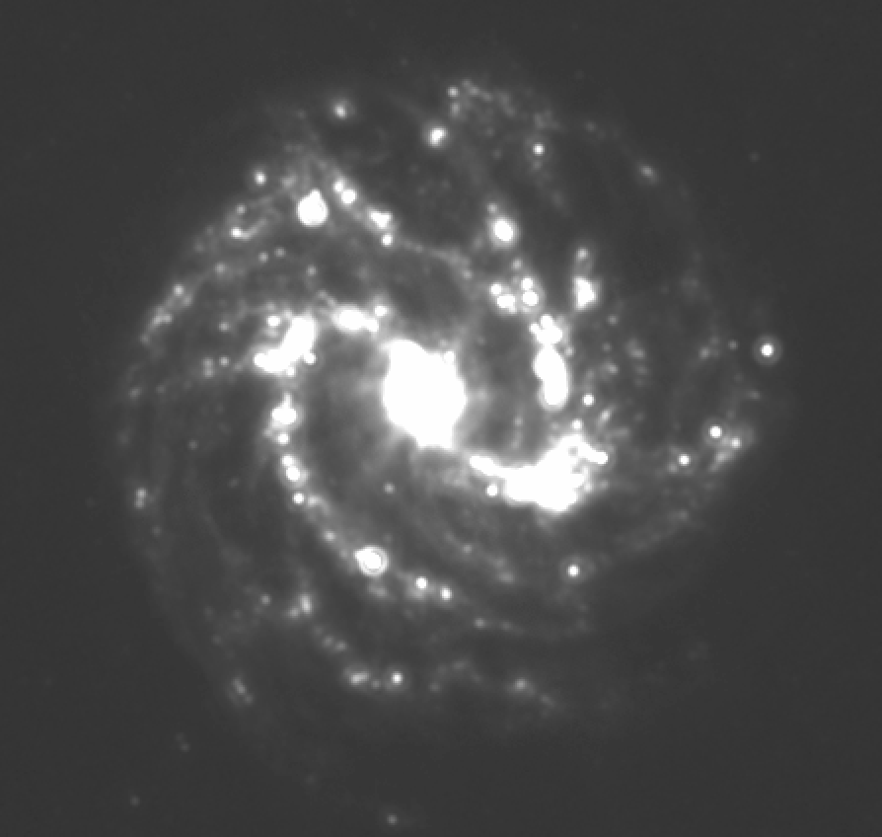
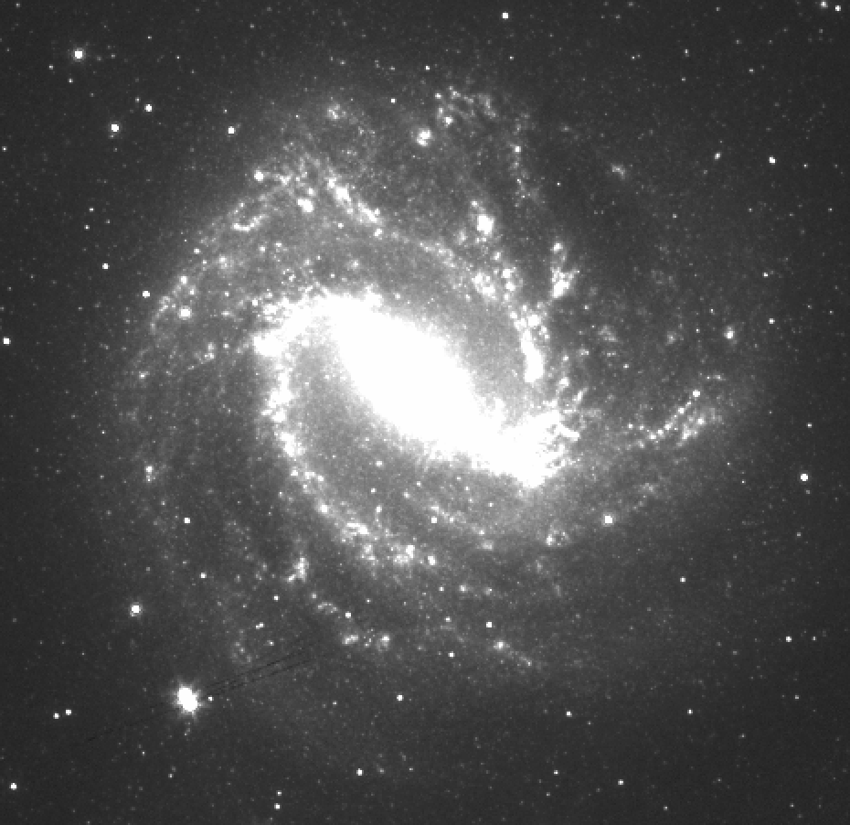
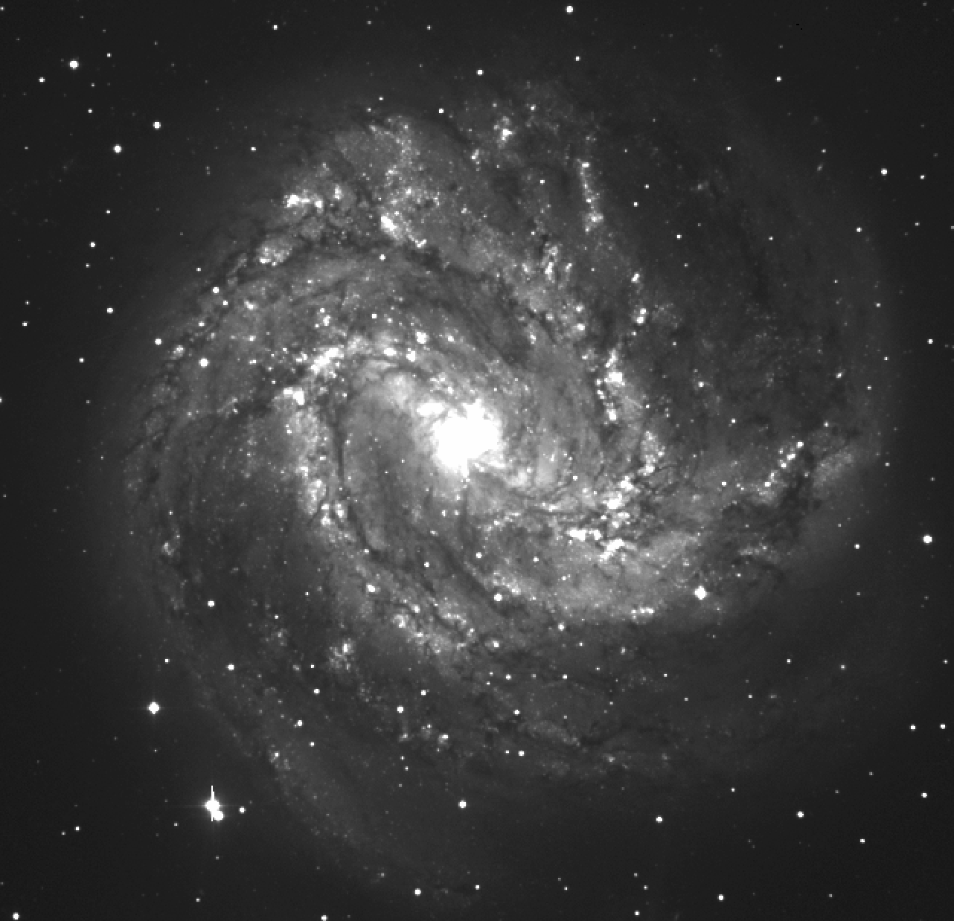
M83’s SPIRAL ARMS
Defined with logarithmic arm equation:
R = Aexp[(^{2π}/_{m}− φ) − tan(i)]
R – radius
A – amplitude
m – number of spiral arms
φ – polar angle
i – pitch angle
Notes:
Explain this is the 3.6 micron image, normal spiril galaxies have log arms
Mention again this is not perfect since there is no standard ways to identify location of feathers
Pitch angle 0 – tightly wound, 90 less tightly wound
Not continuous, segmented

Slide 6
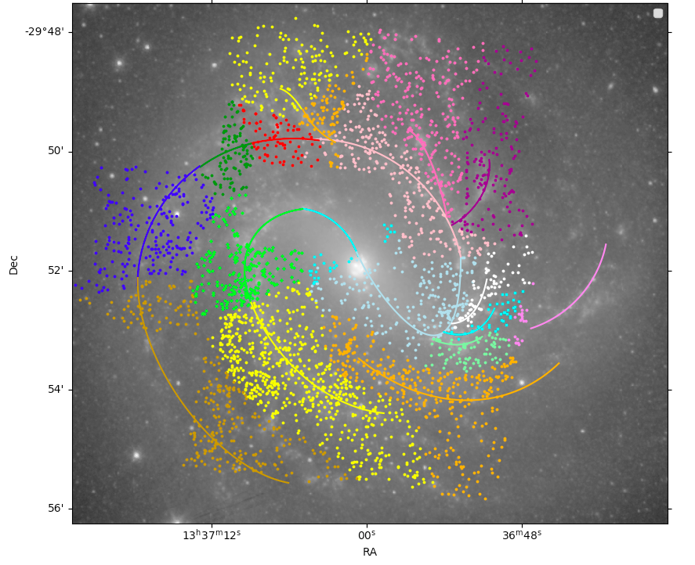
STAR CLUSTERS
N = 3177
18 arm segments
Categorization Criteria:
1. within 2 kpc
2. nearest arm
-29º48’
Fb6
50’
Fb5
52’
Dec
Left:
HST Mosaic Image used to plot star clusters of M83
A3
54’
56’
-23^{h}37^{m}12^{s}
RA
00^{s}
36^{m}12^{s}
Notes:
Put A3, Fb5 (Fb2), Fb6 arm names on figure

Slide 7
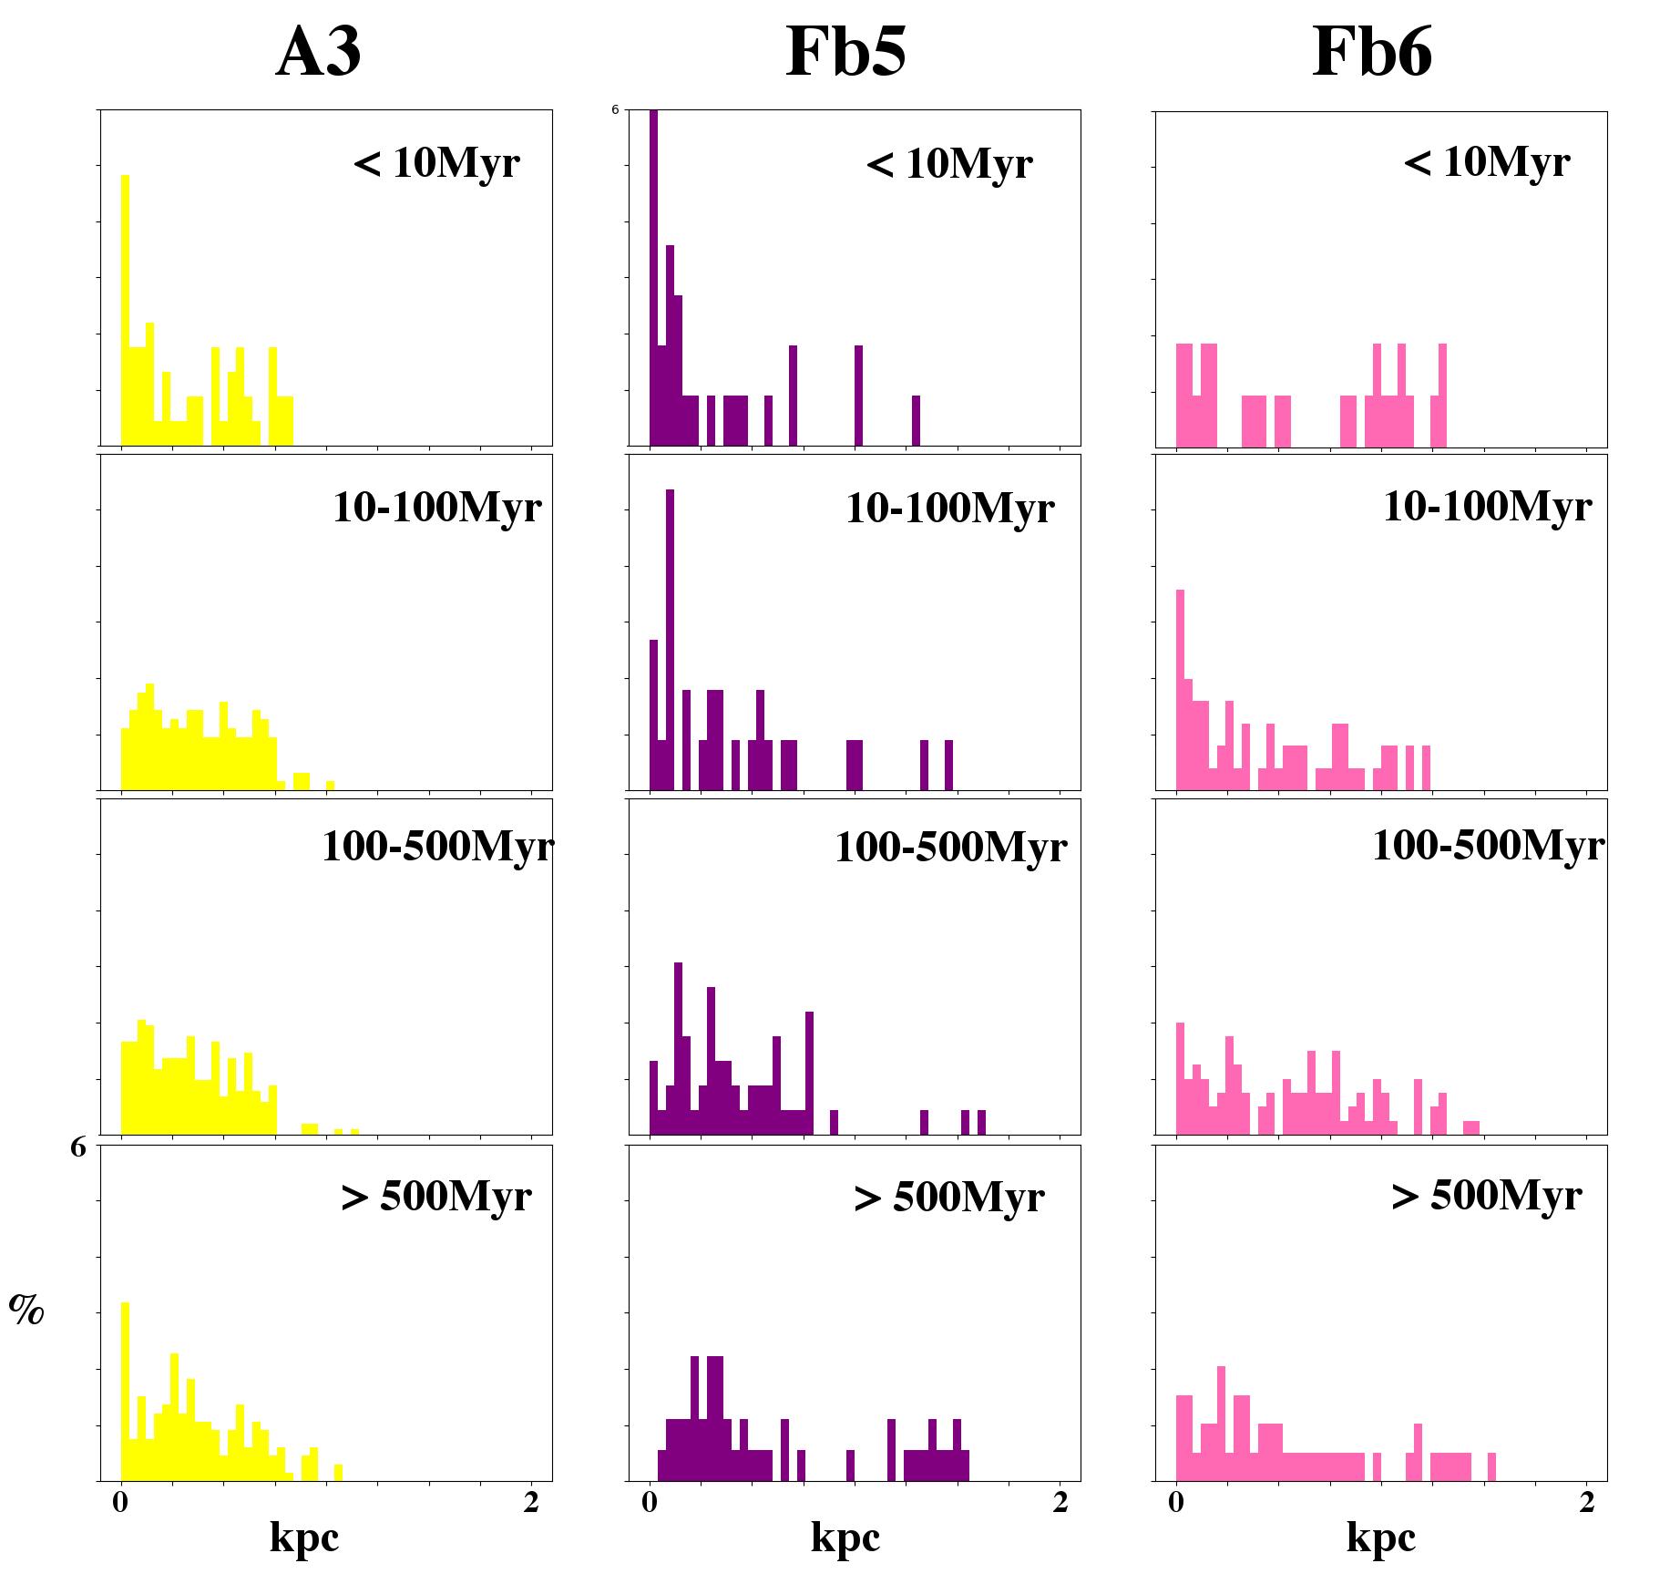
HISTOGRAMS
Star Cluster Distributions
In the arms, younger clusters tend to be found closer to the arm
In the feathers, no obvious age distribution

Slide 8
CONCLUSIONS
M83 arm segments and feathers identified
Analyzed the age distribution of clusters relative to locations of arm segments and feathers
Found
1. age distribution is as expected in the main “normal” spiral arm segments (e.g. A2, A3, B5, B6 etc)
2. in feathers, no obvious age distribution related to the location of feathers
Future
  Apply this study to other spiral galaxy types
  Follow up study on other flocculent galaxies

Slide 9
ANY QUESTIONS?
Acknowledgements:
We’d like to acknowledge Dr. Lisa Chien for mentoring us for the duration of this project. We’d also like to acknowledge Hooper Undergraduate Research Award, as well as Kathleen Stigmon, and Dr. Nadine Barlow at NASA Space grant for the funding and support of this project.

